Slide 1
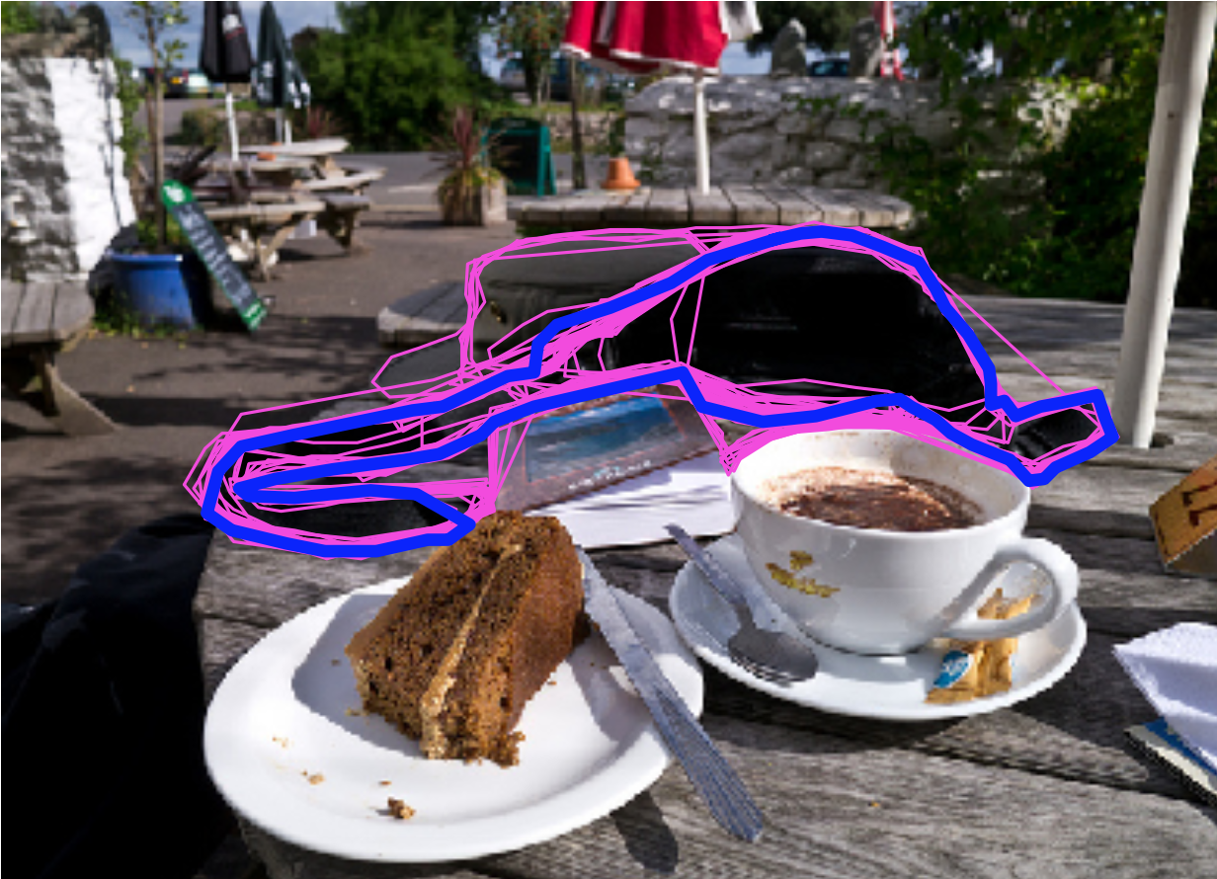
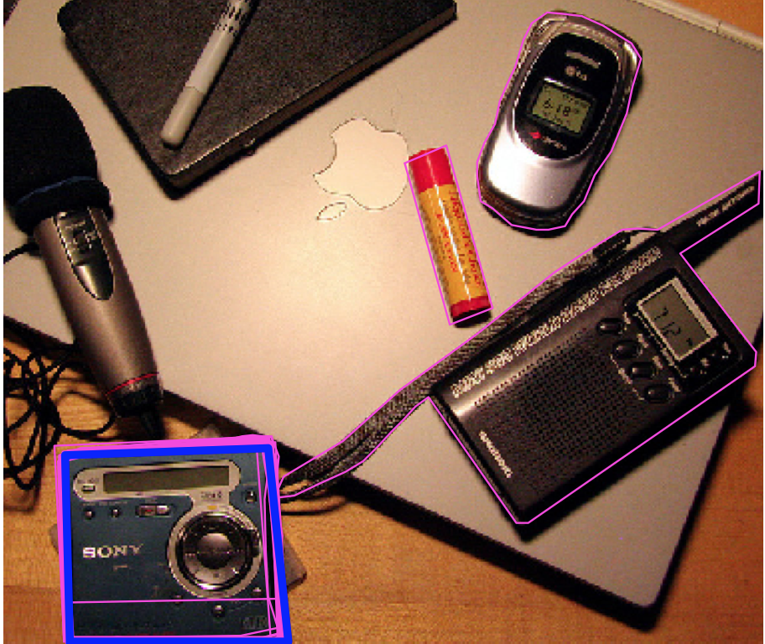
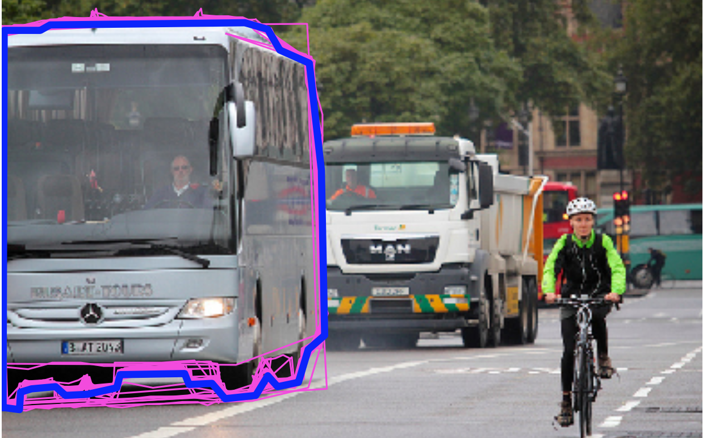
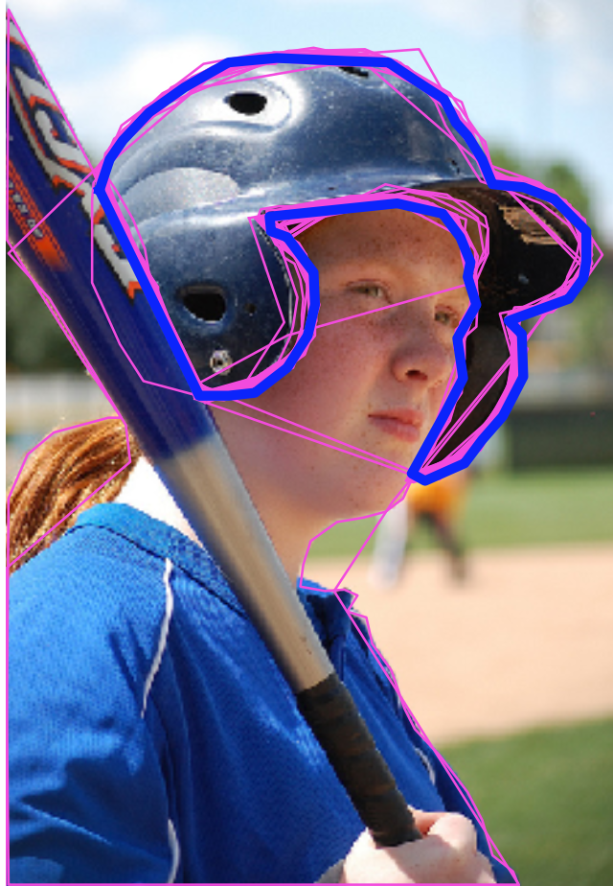
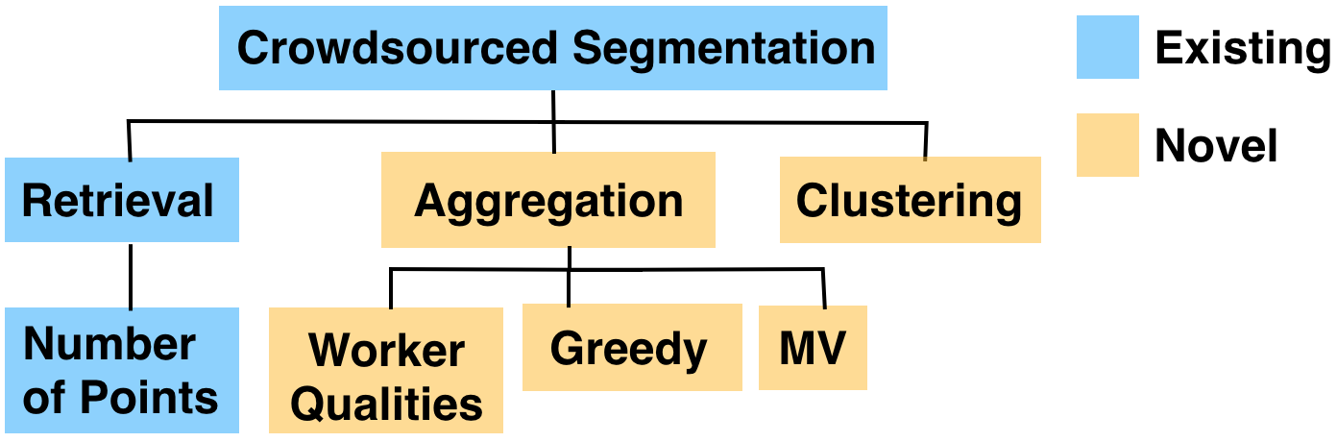
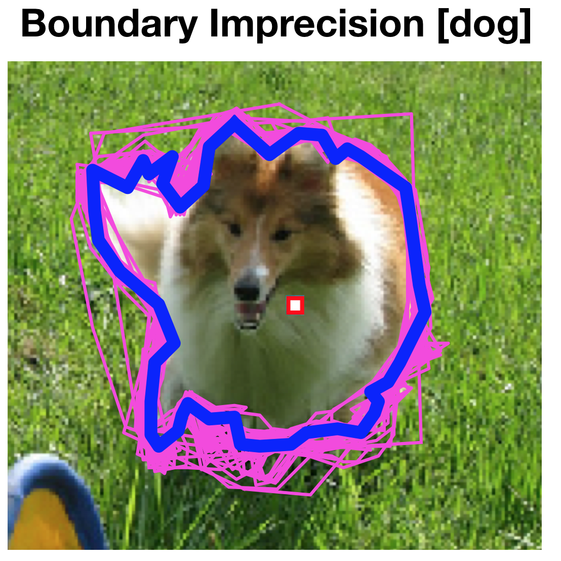
Aggregating Crowdsourced Image Segmentations
Doris Jung-Lin Lee¹, Akash Das Sarma², Aditya Parameswaran¹
¹ University of Illinois, ² Facebook Inc.
Research Overview
Problem Description
Goals:
Precise segmentations around a semantic object
Characterization of common worker errors in crowdsourced segmentation
Contributions:
Clustering for capturing workers with different semantic perspectives
Novel class of aggregation-based algorithms using tile data representation
Worker responses often noisy → quality evaluation
Retrieval-based: pick “best” based on heuristics
Aggregation-based: combine multiple segmentations
Taxonomy of quality evaluation algorithms
Dataset Description & Error Analysis
Perspective Resolution
Spectral clustering on pairwise Jaccard matrix
Preprocess by retaining largest cluster
Improves Jaccard score of algorithms up to 5.92%
Dataset: 46 objects from the MSCOCO, total 1840 segmentations
Semantic ambiguity and errors: wrong subject or portions of objects segmented
Prior work largely focusses on addressing bounding imprecision.
Fixing Boundary Imperfections
Experimental Evaluation
Tile Data Representation
Variants which makes use of ground truth information estimates algorithmic upper bound
Performance scaling as # of workers increases
Tiles: non-overlapping unit of worker segmentations overlaid on each other
Inference on tiles → aggregation across multiple worker segmentations
Worker segmentation → “boolean votes” on tiles
Algorithms
Conclusion
Majority vote: include tile if picked by > 50% workers
Expectation Maximization: infer likelihood that a tile is part of the ground truth segmentation, while simultaneously estimating hidden worker qualities
Greedy Tile Picking: pick tiles in descending order of tiles’ estimated ratios of overlap area with the ground truth
Baseline: Retrieving segmentation with highest number of control points
Contribution: Semantic perspective resolution through clustering and novel tile-based aggregation algorithms Future Work:
Worker qualities good indicators of actual segmentation accuracy, future work on improving inference algorithms
Incorporating vision signals in tile-based inference

